Slide 1
Social Media
NLP
for
Social Media
Social Media
for
Crisis
NLP
Crisis
NLP
for
Crisis
Scope of this manuscript

Slide 2
National crisis cell
Response Teams
Information System
Regional crisis cell
Information processing & mngt
Decision makers
IS Operators
Rescue managers
External sources of information
Local crisis cell
Rescue operators
Information flow

Slide 3
Hub
Community

Slide 4
Danger
Risks
Stakes
Consequence
Event

Slide 5



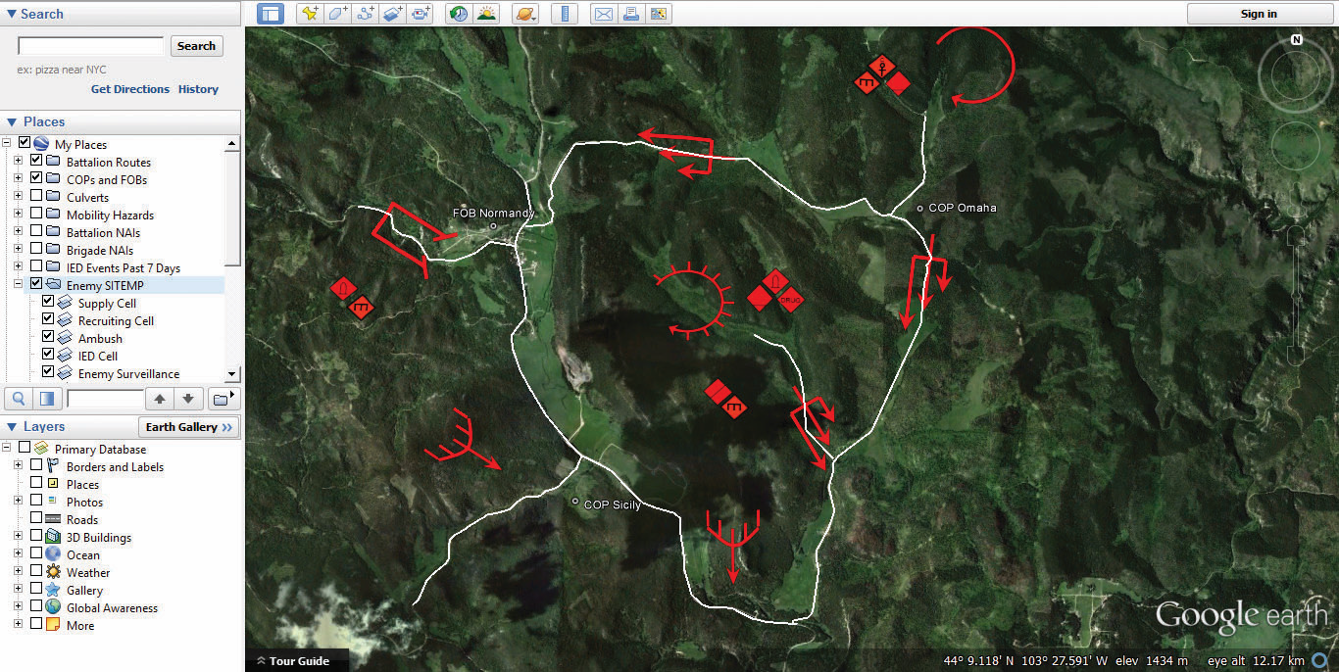







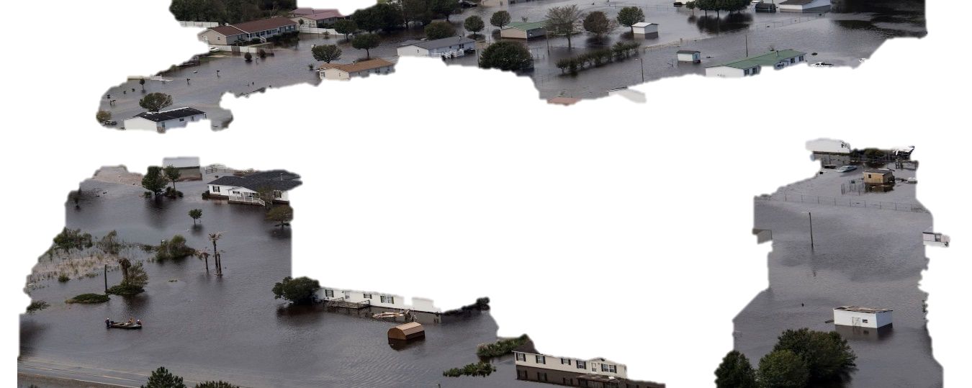
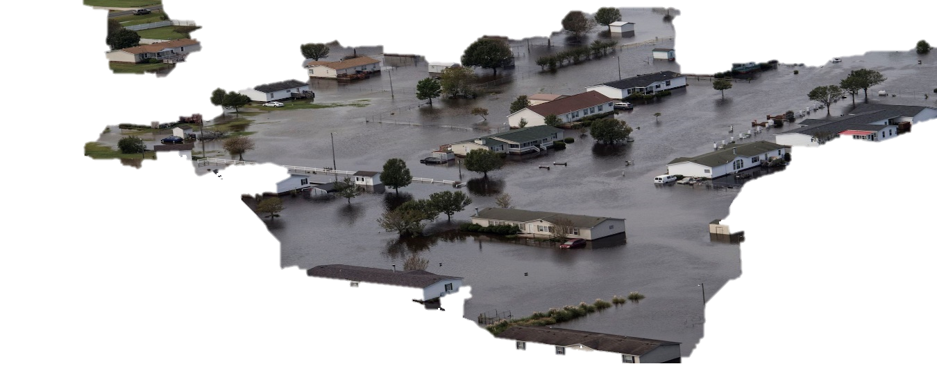




Crisis cell
Decisions
COP
3
1
2
Real World — Crisis Event
Virtual World Social Media

Slide 6
Préfecture
Préfet (decision maker)
Communication team
ZONAL
Level
Firefighter representant
Police representant
Infrastructure representant
Other functions
Police, Gendarmerie
Météo France
Préfecture départementale
SDIS
Weather forecast
DÉPARTEMENTAL
Level
Law enforcement
Operational center Fire and Rescue
Préfet départemental
Calls processing
EMS
DDT
Rescue
Road infrastructure
Coordination
Rescue, Medical care
Mairie
COMMUNAL
Level
Communal Command Center
Fire station
Legend
Coordination
Rescue, Medical care
Information
flow
Order
Terrain
Intervention

Slide 7
Préfecture
Préfet (decision maker)
Communication team
ZONAL
Level
Firefighter representant
Police representant
Infrastructure representant
Other functions
Police, Gendarmerie
Météo France
Préfecture départementale
SDIS
Weather forecast
DÉPARTEMENTAL
Level
Law enforcement
Operational center Fire and Rescue
Préfet départemental
Calls processing
EMS
DDT
Rescue
Road infrastructure
Coordination
Rescue, Medical care
Mairie
COMMUNAL
Level
Communal Command Center
Fire station
Legend
Coordination
Rescue, Medical care
Information
flow
Order
Terrain
Intervention

Slide 8

SDIS 83
VISOV
Representants:
Firefighters
Police
Infrastructure
COD
Communication Cell
Dispatch information and coordination the different services
Simulation Cell
Information
Provides inputs for the different actors according to the exercice plan
Report
Order

Slide 9

SDIS 83
East CGI
CODIS
Call takers
Dispatch and coordination of deployed rescue teams
MSGU Cell
Emergency Response Command
Simulation Cell
Information
Provides inputs for the different actors according to the exercice plan
Report
Order

Slide 10
Information
Organization
“Basic”
Event
Environment conditions
Actors already involved
Responders’ needs
Resources available
Actionable
Location
Credible
Context
Right role
Timely

Slide 11

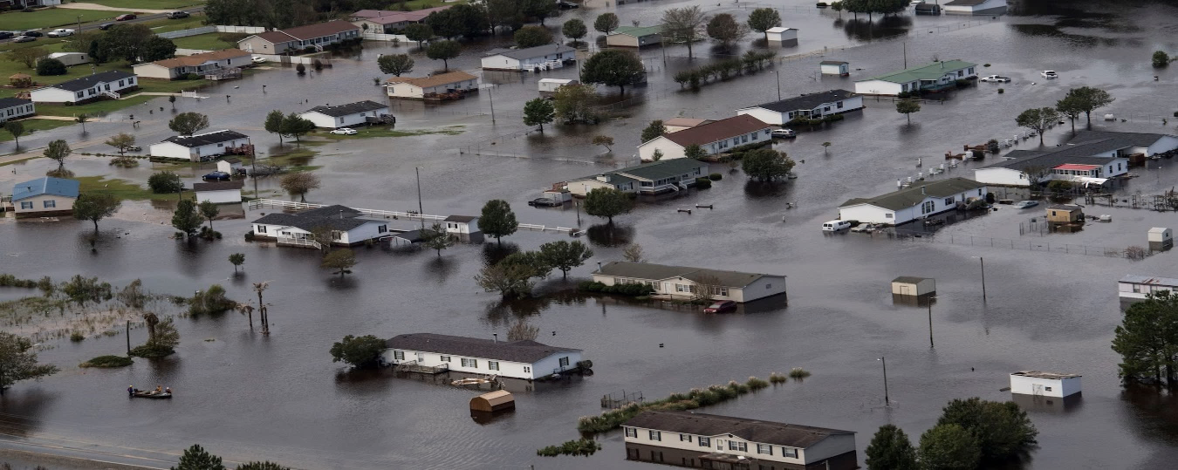






Legend
EMS
Police
Firefighters
Event
Time
t1
t1
t1
t1
Event Location
Event Context
Environ.
Respon.
Needs
Resources

